Slide 1

Shopping Management System
Enhancing Product Sales Strategy
1 August 2025

Slide 2
Team Members
GopalKrishna
Abhishek K M
Rohan V I
Samruddi
Anit Veeramani

Slide 3
List of Contents
Problem Statement
Challenges Faced
Functional Requirements
Non-Functional Requirements
Scope
Database Tables
ER Diagrams
Use Case Diagrams
Sequence Diagram

Slide 4
Contents
Entities
Software and Hardware Requirements
Screens/Flow

Slide 5

Problem Statement
Customers need to visit stores physically or navigate unorganized websites to browse or purchase products.
Customers struggle to browse or purchase efficiently.
A user-friendly online platform solves this by streamlining shopping and product management.

Slide 6

Challenges Faced
Ensuring reliable shopping experience
Securing user data
Creating intuitive and friendly UI
Performing usability testing across users
Handling complex user navigation paths

Slide 7

Functional Requirements
Admin:
User:
Manage product catalog (Add, Edit, Delete)
Register/login with secure authentication
Approve/reject new products or categories
Browse and search products by category
Add to cart and checkout
Monitor user activities and transactions
Track order status and view order history
View Sales Reports
Edit profile,
Handle order processing and shipment updates

Slide 8

Non-Functional Requirements
Application must be user-friendly.
System must ensure high-level security for user data.
All critical actions and changes must be traceable and logged.
Logs of important events and errors must be maintained in date-based log files.
Application should load quickly with optimized API and UI response times.
System must be scalable to support high user and product traffic.
Architecture must support separation and distribution of components across tiers.

Slide 9

Scope
Customer :
Login & Registration
Browse & Search Products
Filter Products by Category
View Product Details
Add/Remove Products in Shopping Cart
View & Edit Shopping Cart
Checkout & Place Order
View Order Confirmation
View Order History

Slide 10

Admin:
Secure Admin Login
Add New Products with Full Details
Update or Delete Product Information
View All Products
Manage Product Categories
Dashboard with Key Metrics
Admin Logout

Slide 11
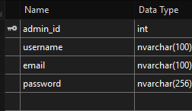
Database Tables
Admin:

Slide 12
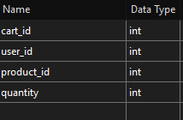
Cart:

Slide 13
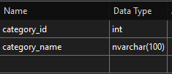
Category:

Slide 14
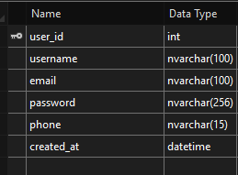
Customer:

Slide 15
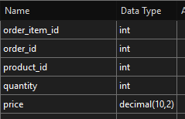
Order:

Slide 16
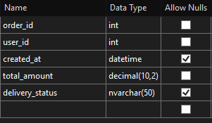
Orders:

Slide 17
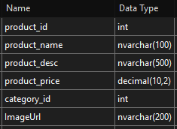
Products:

Slide 18
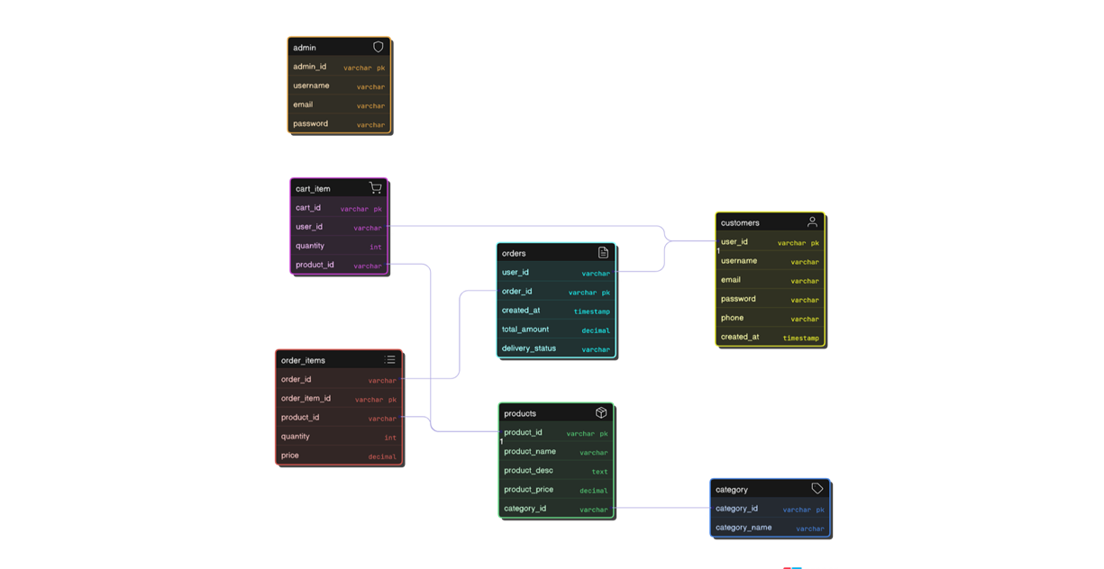
ER Diagram

Slide 19
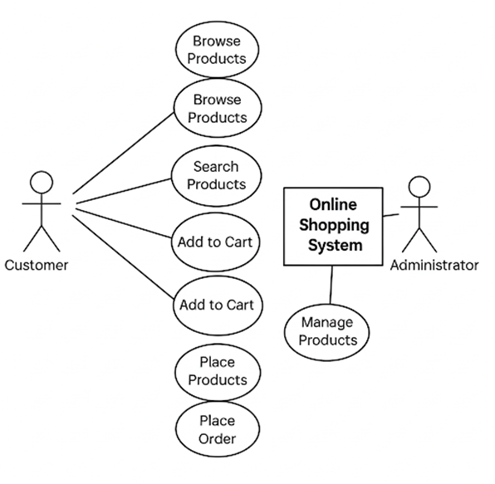
Usecase Diagrams

Slide 20
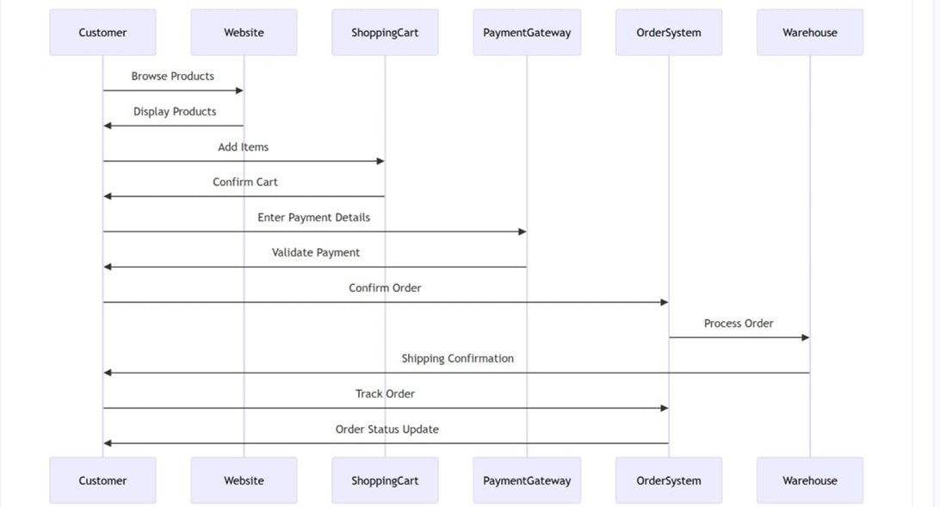
Sequence Diagrams

Slide 21

Software And Hardware Requirements
Operating system Windows.
Language C sharp.
Softwares SQL management studio.
Visual studio.
Visual studio code.

Slide 22

Entities
Admin
Cart
Category
Customer
Order
Orders (Order history)
Products

Slide 23
Screen Flow (UI)

Slide 24
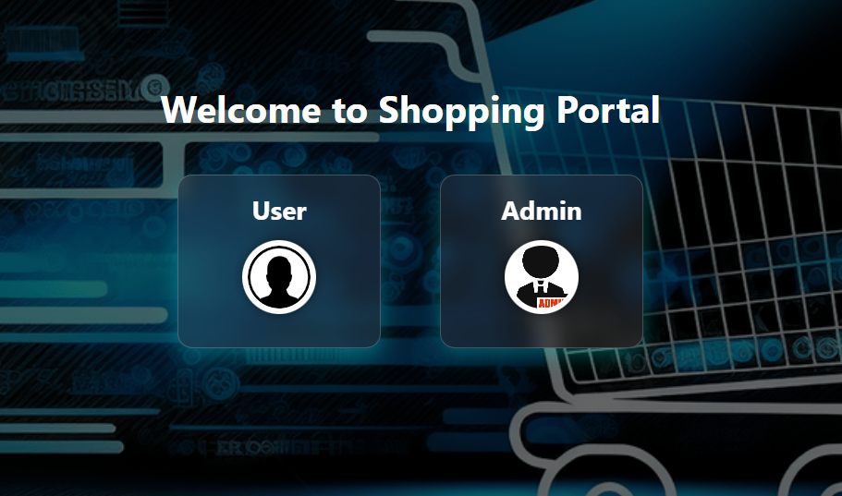
Welcome page

Slide 25
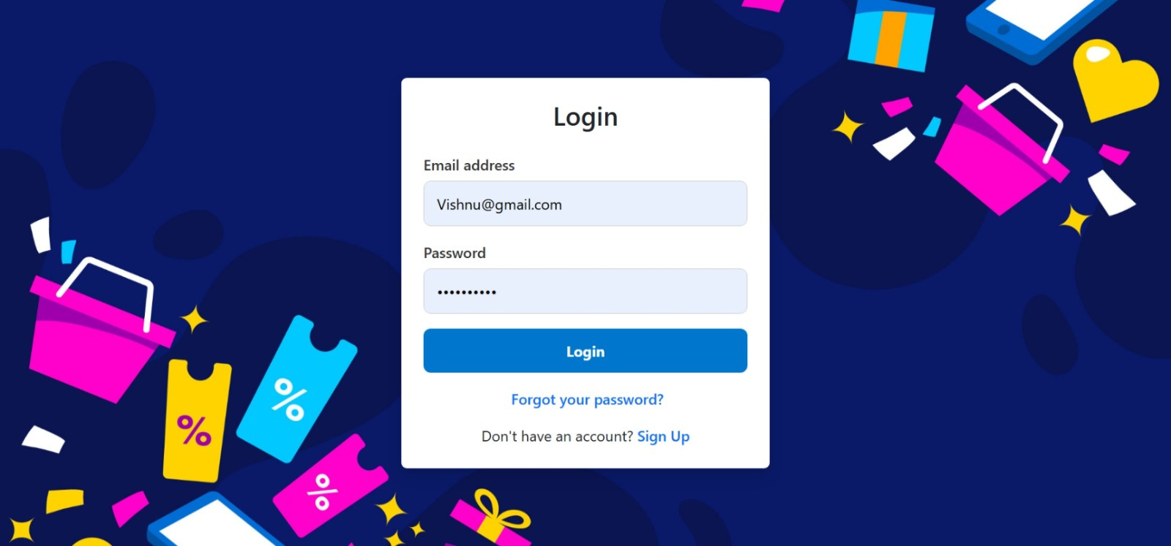
Login page

Slide 26
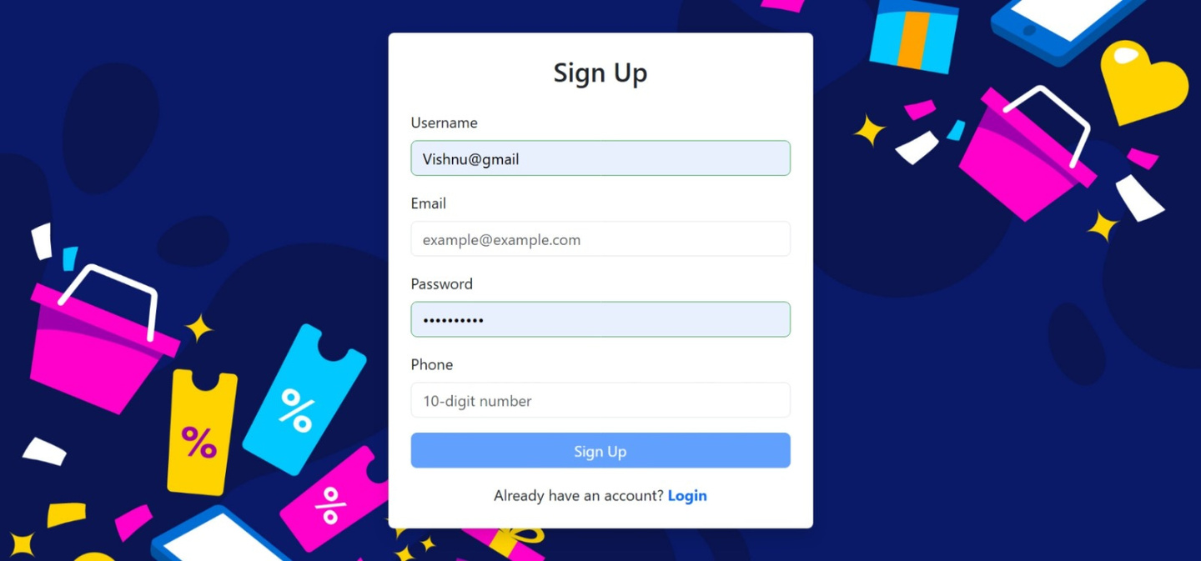
Register page

Slide 27
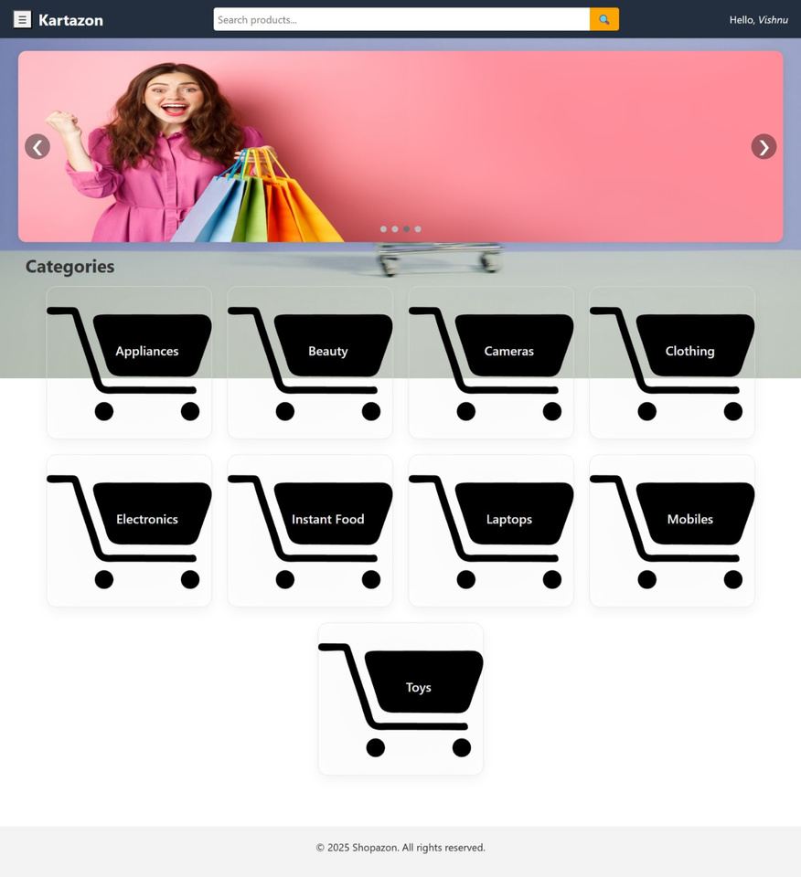
Home page

Slide 28
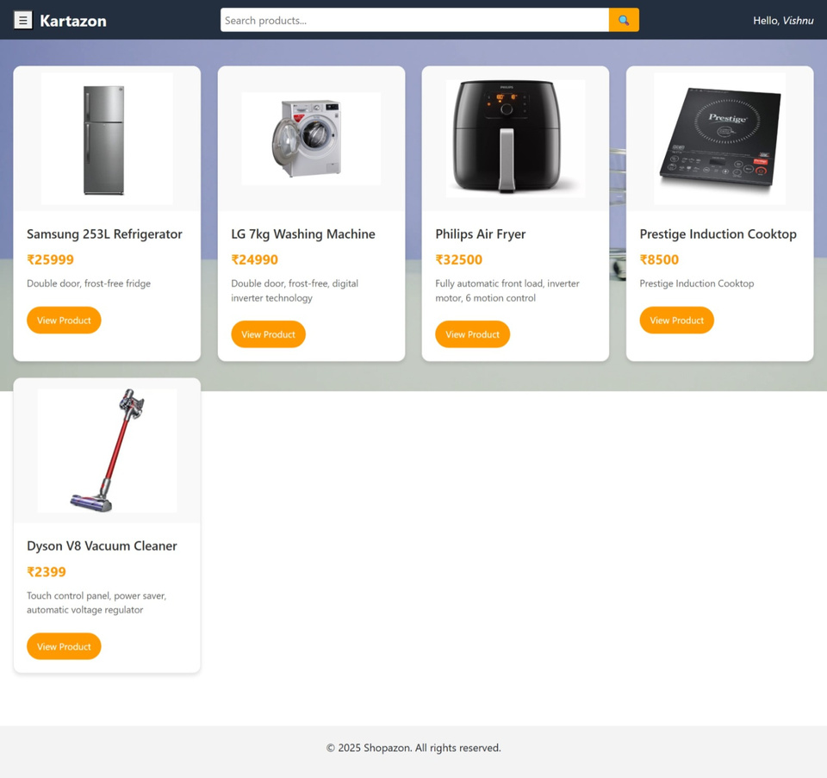
Products by category

Slide 29
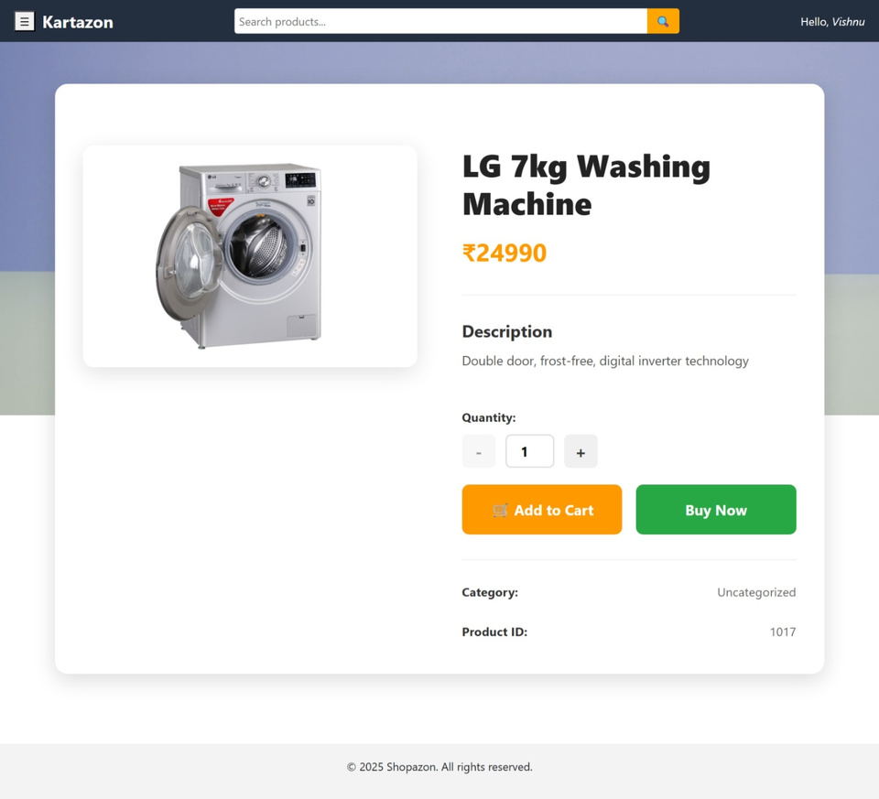
Products details page

Slide 30
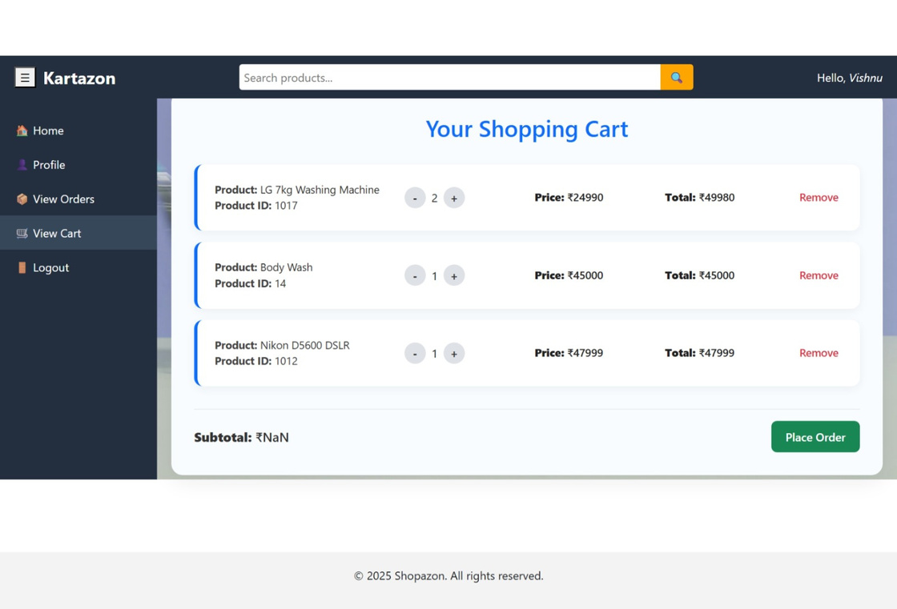
Cart page

Slide 31
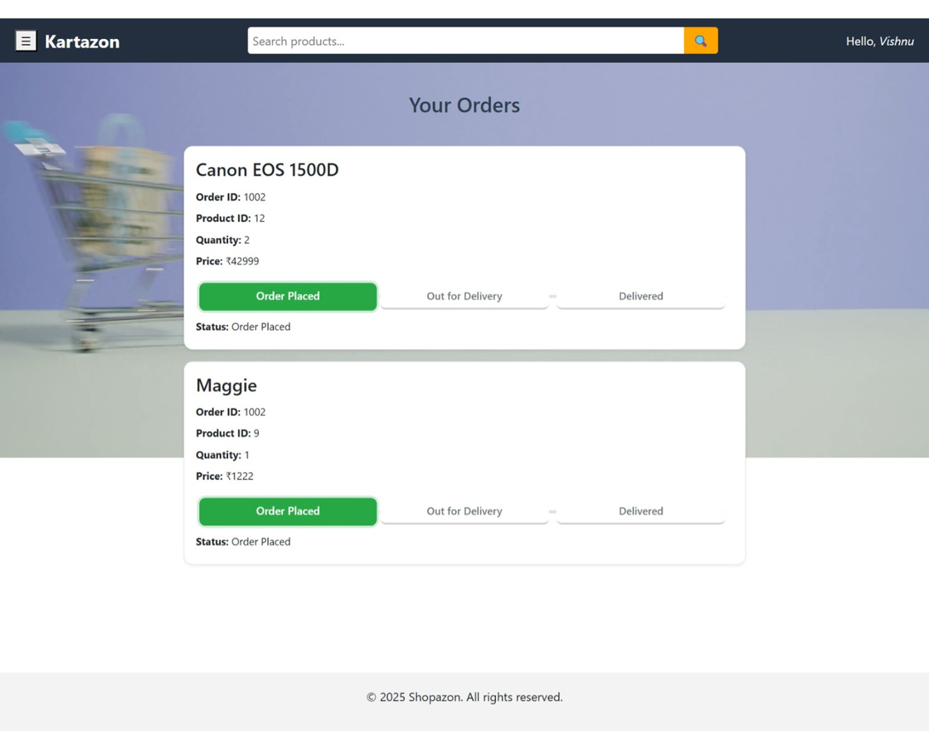
Orders page

Slide 32
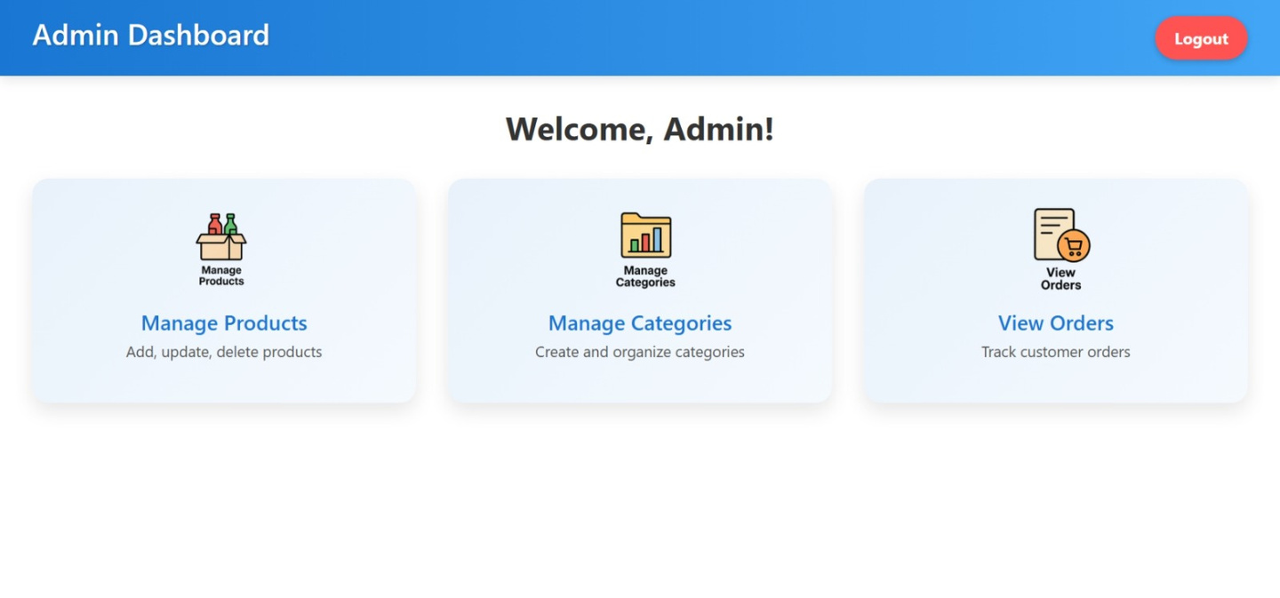
Admin homepage

Slide 33
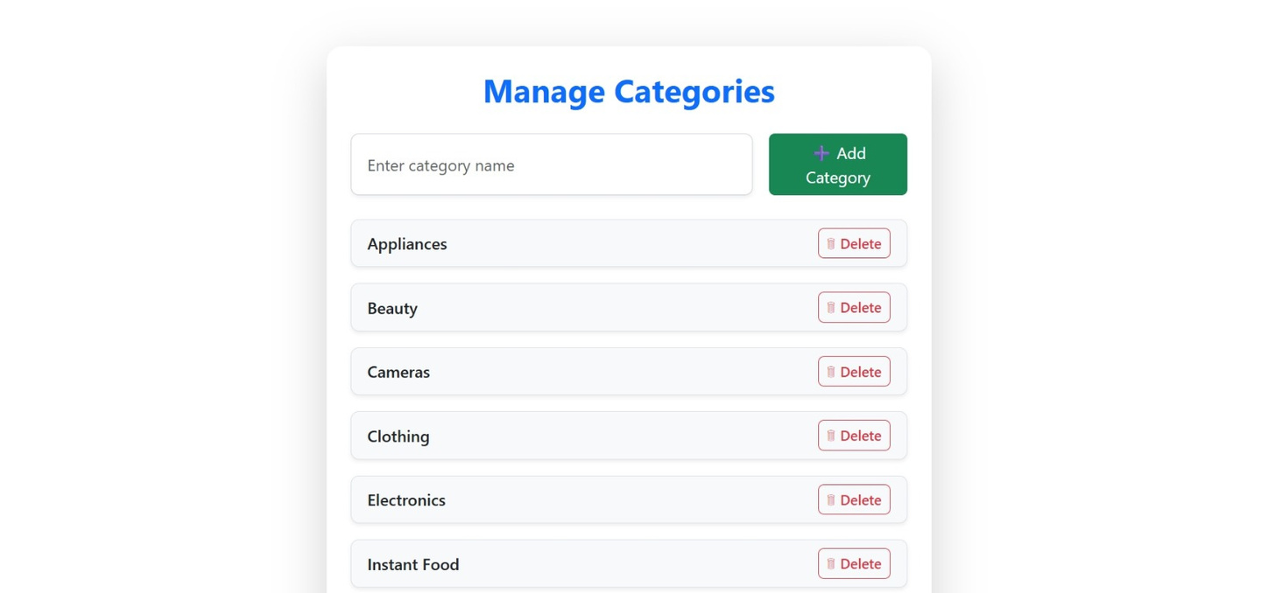
Manage Categories

Slide 34
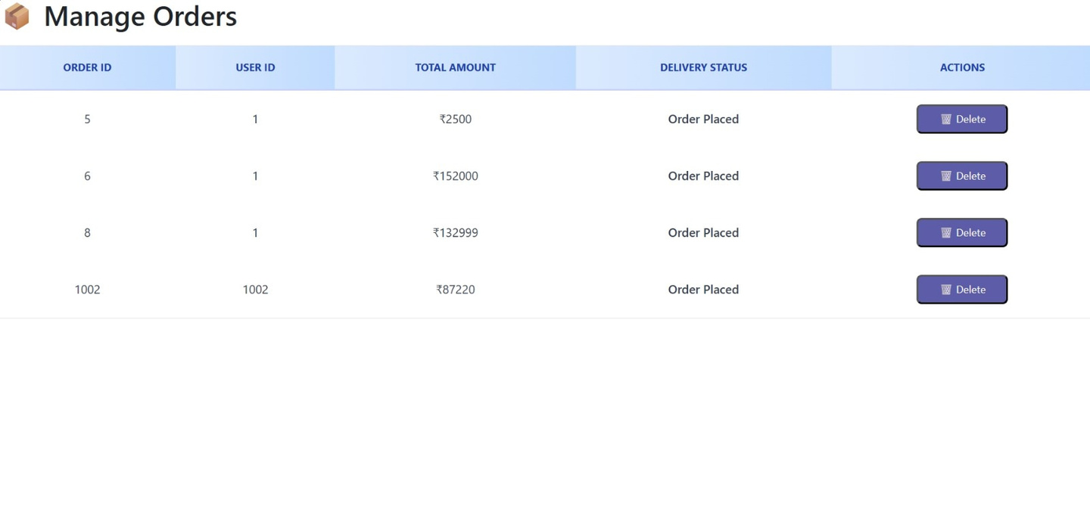
Manage Orders

Slide 35
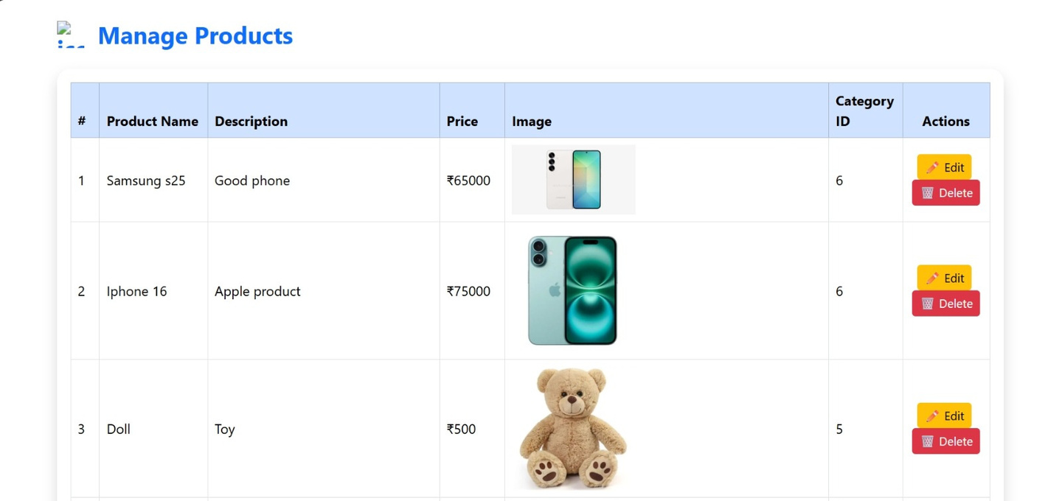
Manage Products

Slide 36
Conclusion
By developing a secure and user-friendly online shopping system, our goal is to streamline the buying experience for customers and simplify inventory and order management for administrators, ensuring long-term scalability and efficiency.

Slide 37
Thank you

